Slide 1
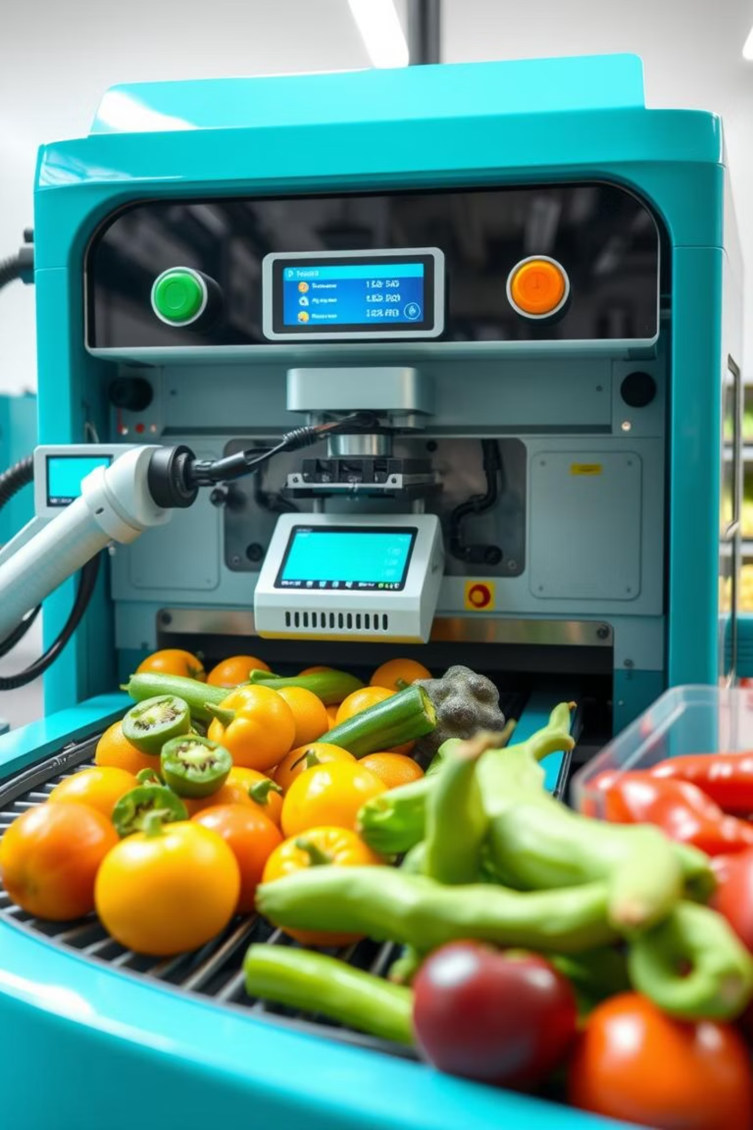
Smart Sorting – Transfer Learning for Identifying Rotten Fruits and Vegetables
TEAM MEMBERS:
A.Jyothendra Sai Ram
B.Bindu Bhargavi
B.Siddhardha Bheem
B.Himanth

Slide 2
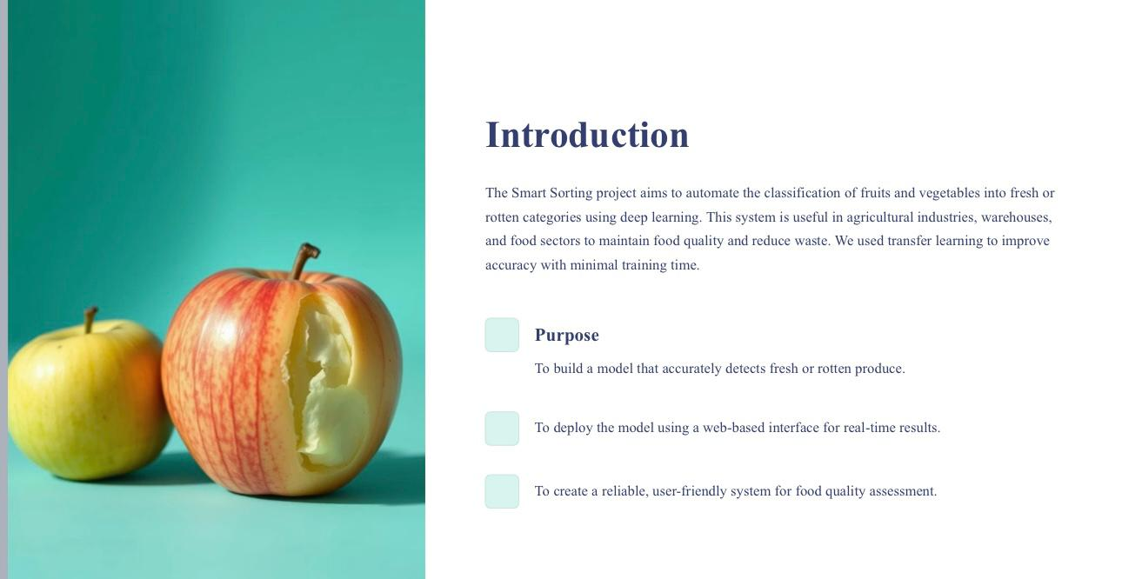

Slide 3
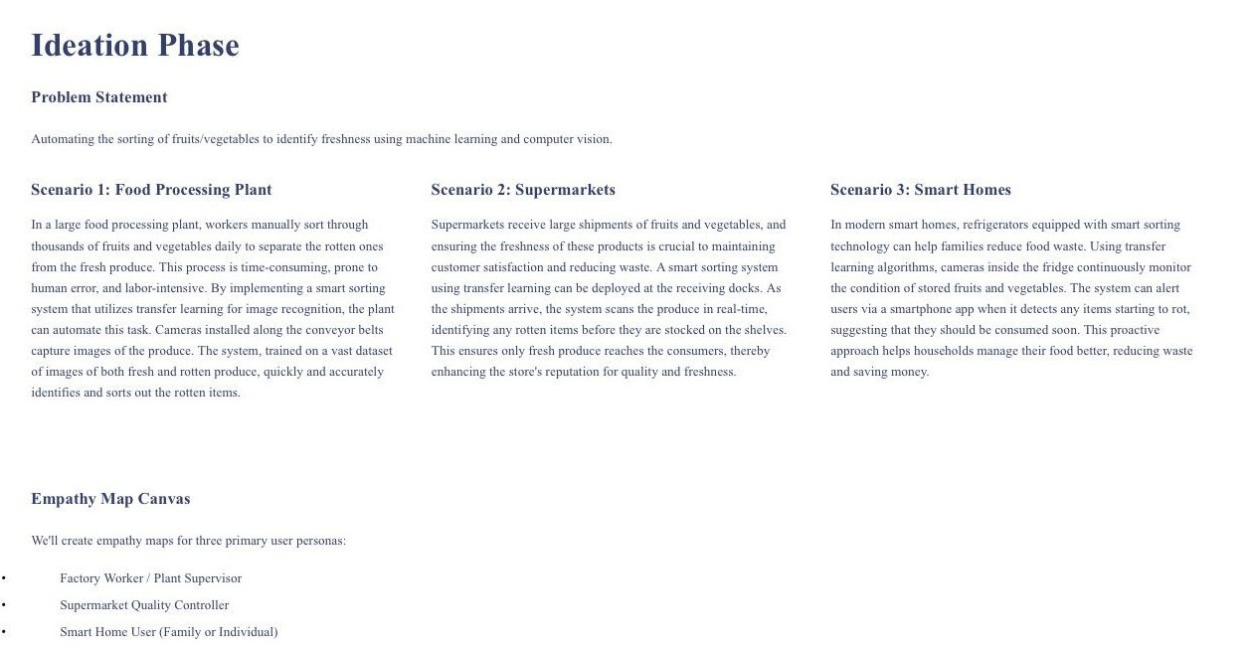

Slide 4
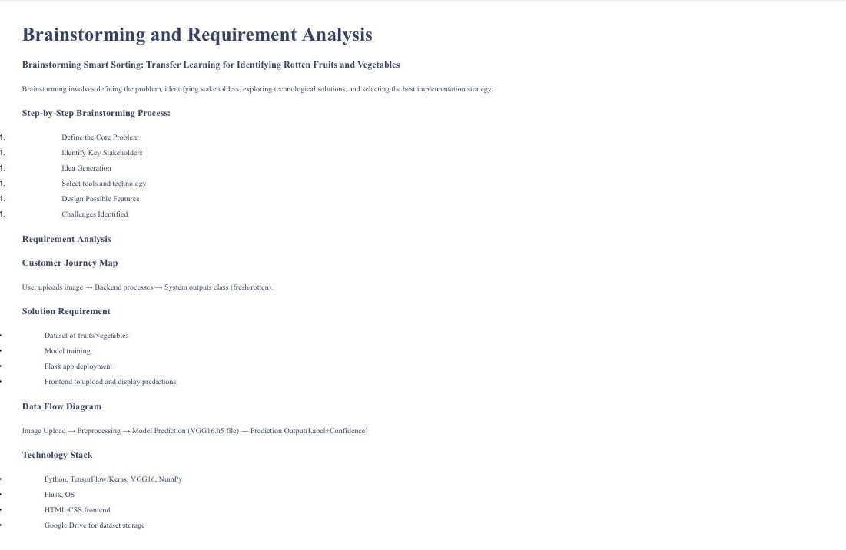

Slide 5
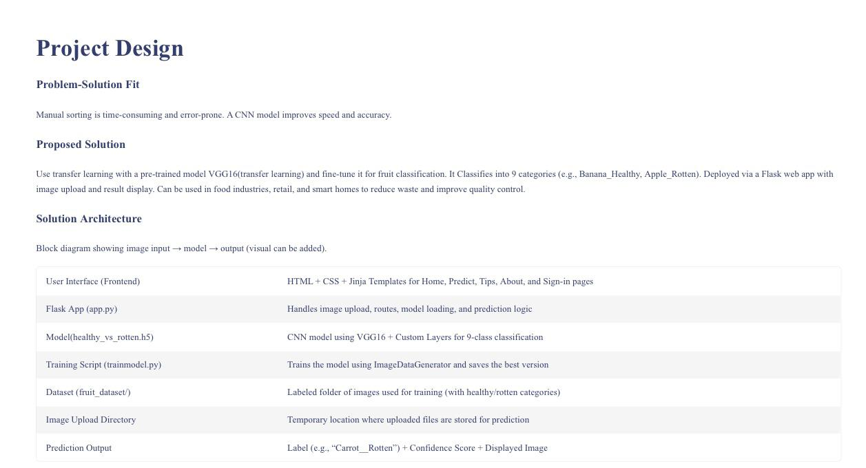

Slide 6
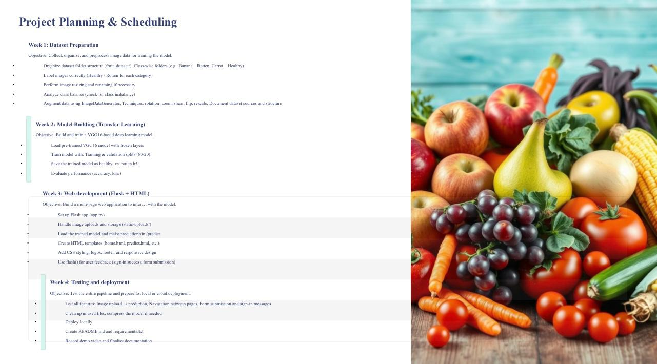

Slide 7
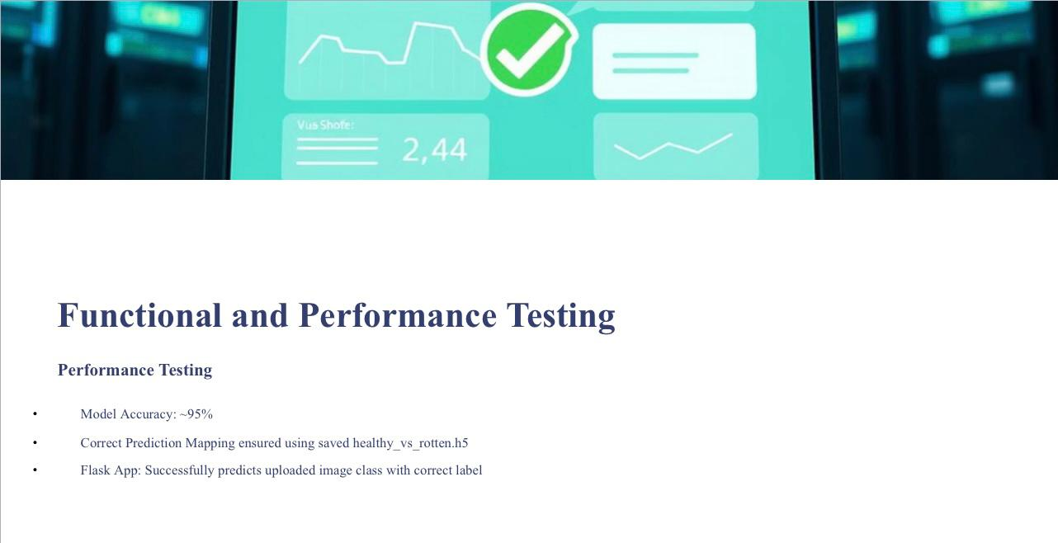

Slide 8
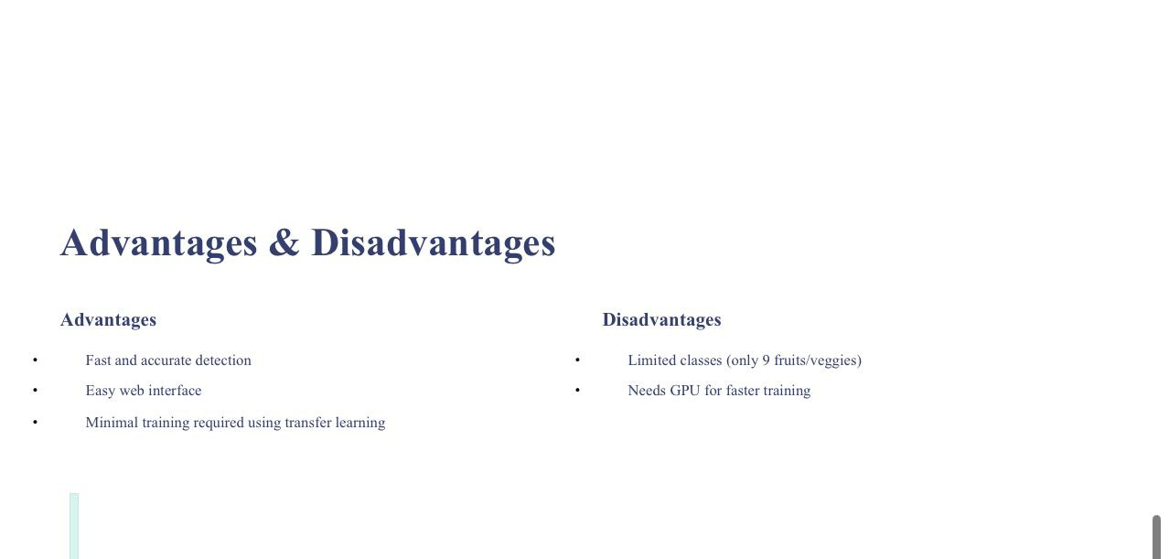

Slide 9
